Slide 1
Introduction
Computer Vision

Slide 2
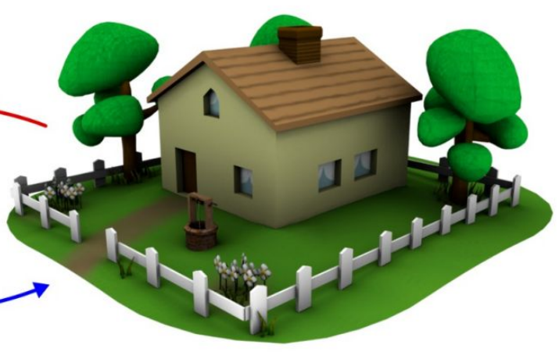
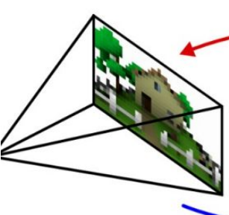
Goal of Computer Vision
extract semantic information from digital image data
to be used for decision making support or automated systems
challenging problem:
images are only 2D projections of the 3D world
nowadays heavily powered by artificial intelligence (AI), especially machine learning (ML)

Slide 3
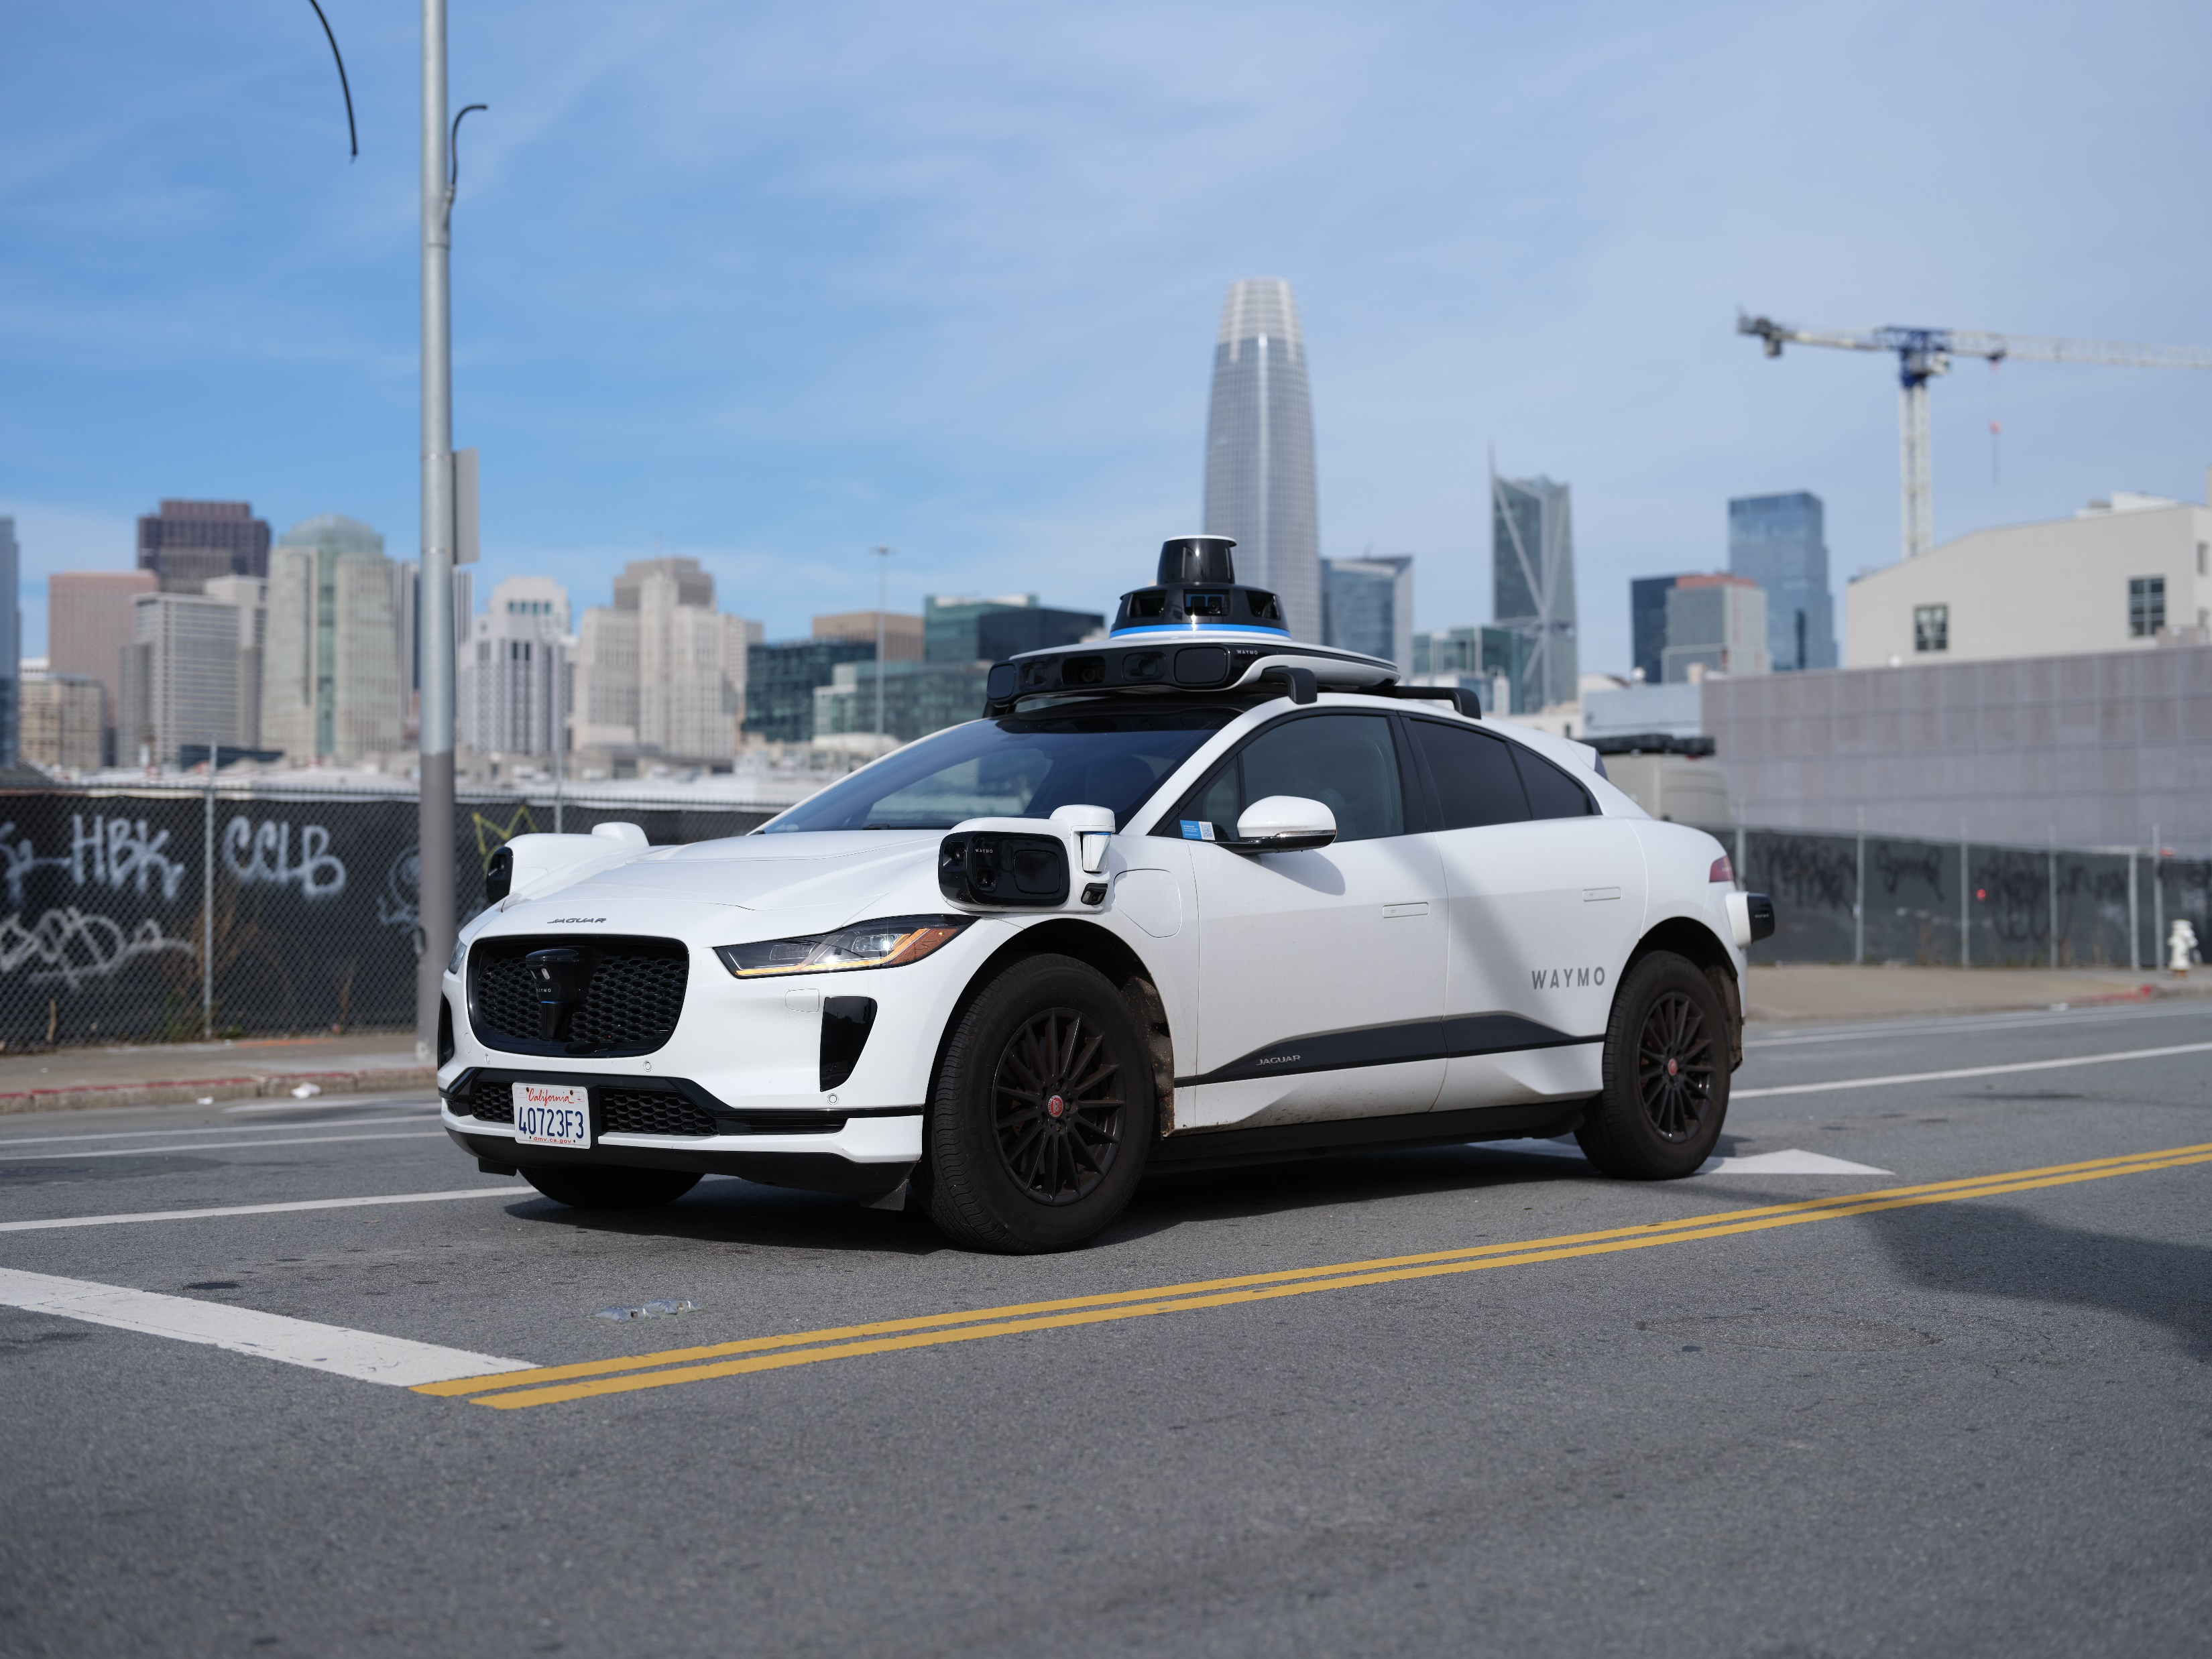


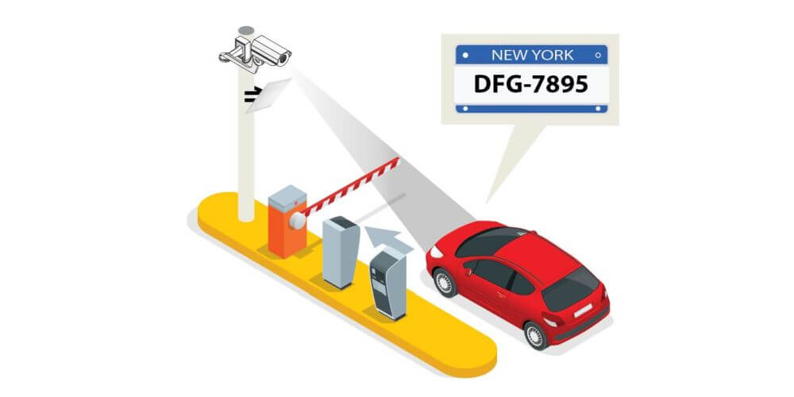
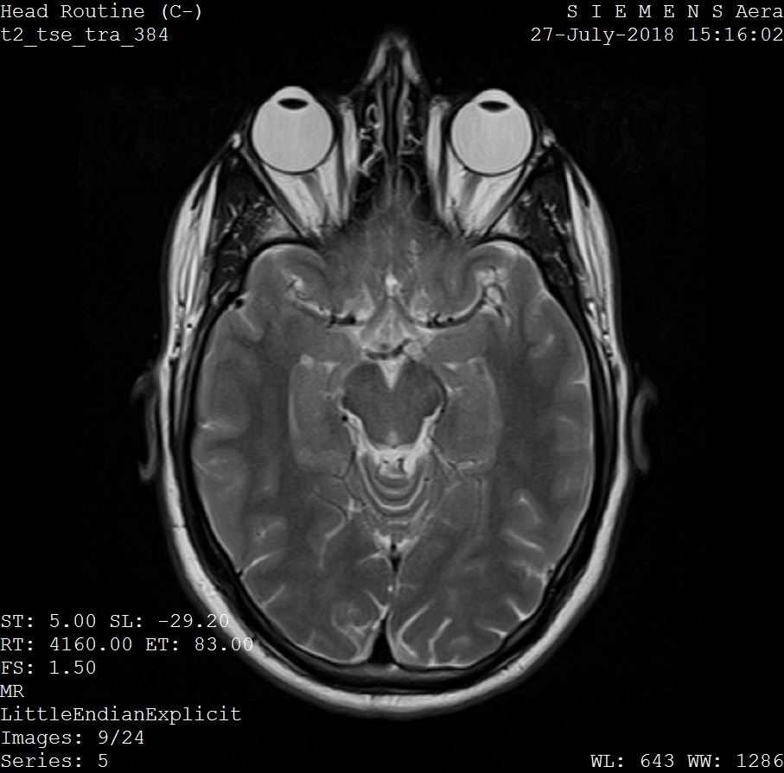
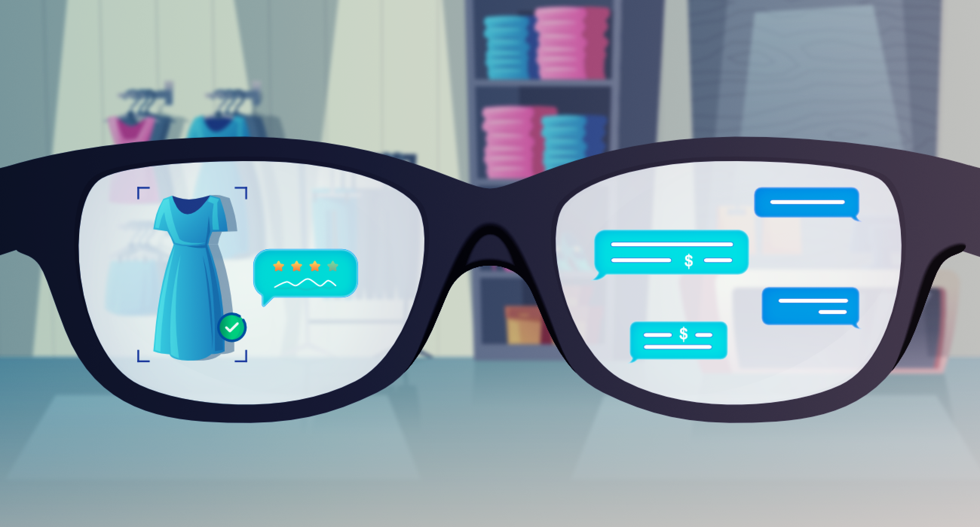
Applications of Computer Vision
autonomous driving
facial recognition
automated inspection
medical imaging
optical character recognition
augmented reality
and many more …

Slide 4
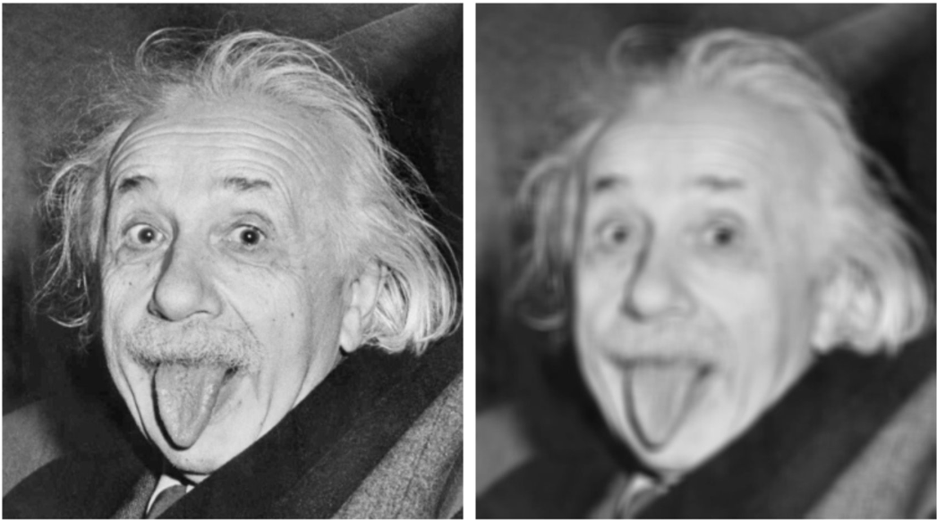
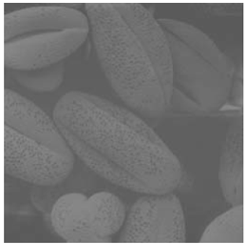
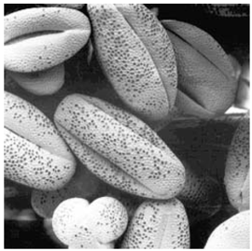
Image Processing
transformations from image to image
(such as scaling, smoothing, sharpening, or contrast stretching)
to facilitate either machine perception or just human interpretation

Slide 5
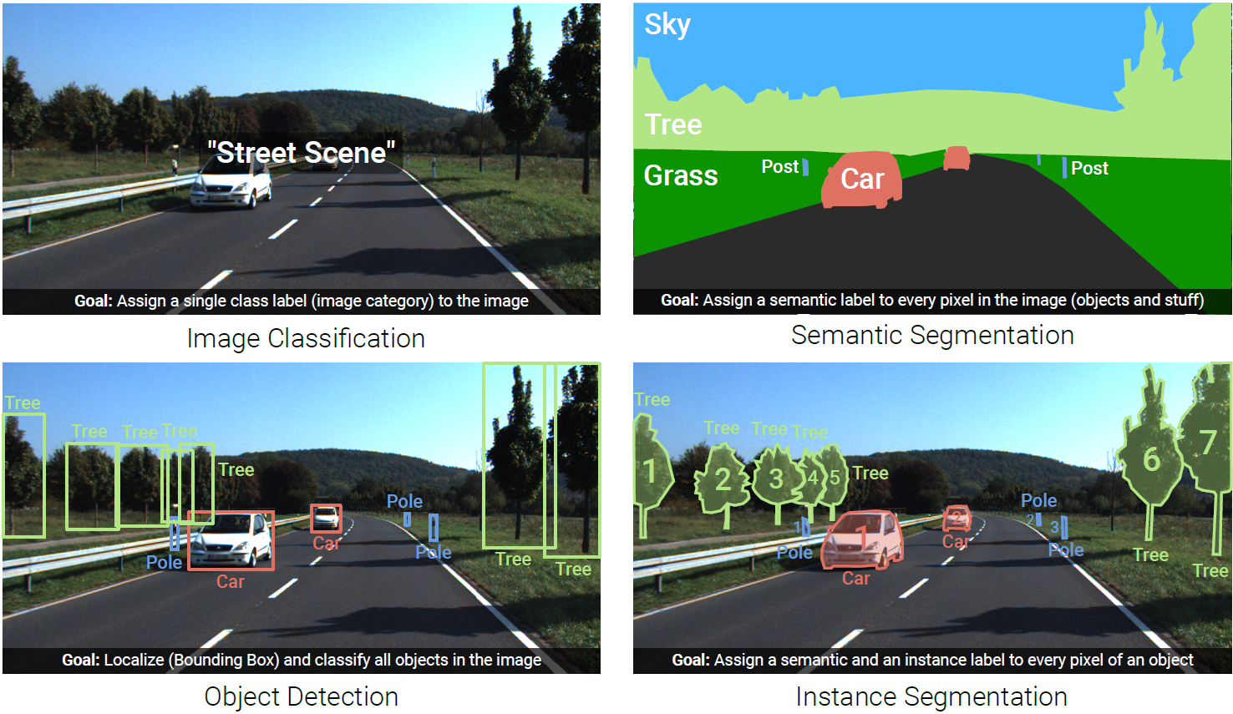
Image Understanding (Recognition)

Slide 6
Course Schedule
Part 1: Old-School Computer Vision
Digital Image Processing image formation, intensity transformations, compression, spatial filtering, Fourier transform, aliasing, image pyramids
Edges and Features Canny & Marr-Hildreth edge detectors, Hough transform, feature detection (Harris corner detector) and description (SIFT), feature matching, eigenfaces
Projective Geometry geometric transformations, image alignment, stereo vision, camera calibration
Part 2: Machine Learning
Image Classification: From Classic ML to Deep Learning supervised learning, linear regression, bias-variance tradeoff, neural networks, convolutional neural networks, transfer learning, transformers (language models, ViT, DINO, CLIP)
Segmentation and Detection semantic segmentation, object detection (R-CNN, YOLO), object tracking, instance segmentation, promptable segmentation
Image Synthesis generative models, GAN, VAE, diffusion

Slide 7
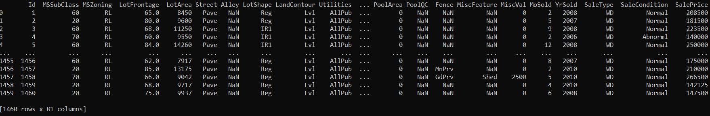
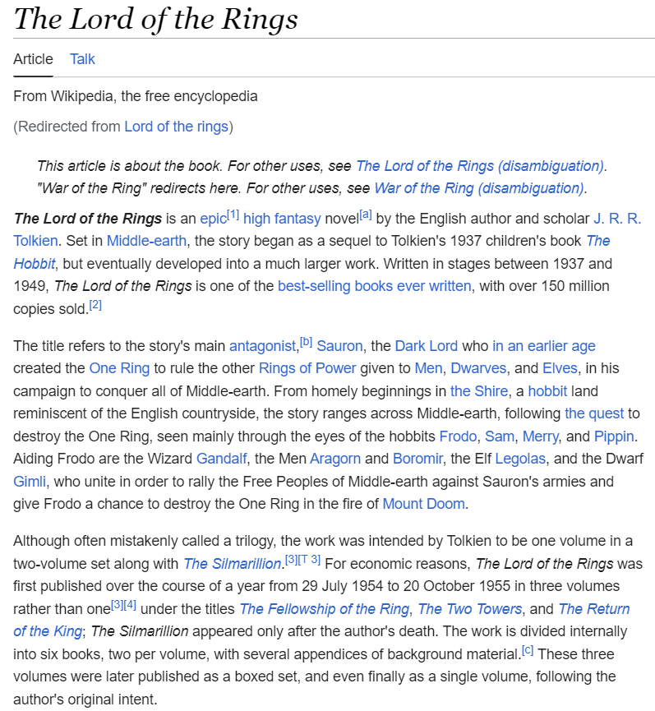
Main Areas of AI/ML
empowered by one key component: learning from data (ML)
tabular data
language models
computer vision
control

Slide 8


When to Use ML (Learning from Data)
automation
too complex for rules
uncertainty
too complex for humans
AlphaFold
object recognition, chat bot, …
protein structure predictions, demand forecasting, …

Slide 9
blend of diverse components from different domains (statistics, optimization, computer science, …)
Artificial Intelligence
Machine Learning
Deep
Learning
Deep Learning: special kind of ML methods using deep neural networks (e.g., CNNs, transformers)

Slide 10





Used Programming Language: Python
good compromise between rapid prototyping and production
vast ecosystem
very popular for data processing and ML: scientific Python stack

Slide 11



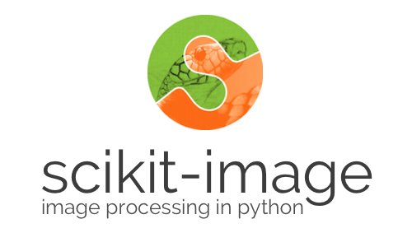
Used Python Libraries
computer vision:
deep learning:

Slide 12
Programming Environments
locally, best use
a virtual environment to flexibly install packages (e.g., venv)
an IDE of your choice (e.g., VS Code)
both plain Python files or Jupyter notebooks are fine
but cloud-based environments also fine (e.g., Google Colab)

Slide 13
Literature
Computer Vision: Algorithms and Applications
Digital Image Processing, Gonzales & Woods
Deep Learning
The Little Book of Deep Learning
Understanding Deep Learning

